Slide 1
A Project on Computer Graphics
-
3D Mirror
By:
Aashish Poudel (060BEX401)
Anup Shrestha (060BEX405)
Bikash Sharma (060BEX407)

Slide 2
Objectives
Utilize various techniques and algorithms of Computer Graphics.
Draw output primitives such as line, circle, ellipse, polygons and use them to draw various 3D shapes.
To be able to understand 3D object representation using polygon tables including vertex table, edge table and surface table.
Become familiar with attributes of objects like line type, color, fill styles, fill color etc.

Slide 3
Objectives…
To simulate the mirror reflection of some specific 3D objects.
Perform various 3D transformations like rotation, scaling on objects and view their corresponding changes in mirror image.
Understand algorithms for visible surface detection.
Understand algorithms on Illumination Models and Surface Rendering Methods such as Diffuse Reflection, Specular Reflection, Ambient Reflection and Polygon rendering methods such as Constant Intensity Shading.

Slide 4
Introduction
Computers - powerful tool for rapid and economical creation of 2D and 3D graphics.
Simulation of virtual 3D world can be done in a 2D computer screen.
Used in science, engineering, medicine, business, industry, government, art, entertainment, advertising, education and trainings, in user interface, data visualization, television, commercials, motion pictures, simulation and much more.

Slide 5
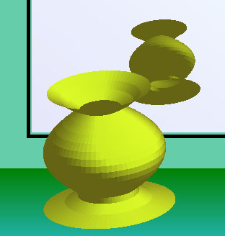
Introduction to 3D Mirror
This project - visualization of different 3D objects from the Z axis and their mirror images in a 3D world.
3D objects are modeled by using vertex and surface tables.
Algorithms like hidden surface detection and different lighting models are used for improving the realism.

Slide 6
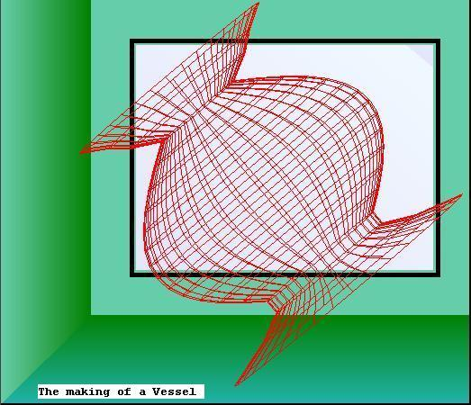
Vertex and Surface Table
Vertex Table
  stores the coordinates of the vertices. i.e. x, y, z and w (homogenous)
Surface table
  4 vertices of the surface
  ABCD parameters
  color value of surface

Slide 7
Visible Surface Detection
‘Back-Face Detection’ algorithm is used.
Here the A, B, C, D parameters are calculated using the three vertices taken in anticlockwise order and solving the matrices.
If V be a vector in viewing direction from the eye position then the surface faces backwards if V.N>0.
Here viewing direction is towards negative Z axis. So V.N=-C

Slide 8
Visible Surface Detection …
So the surface with ‘negative C’ indicates that the back face of the object is seen and we do not draw it. Only the surface with ‘positive C’ is drawn.
The painter’s algorithm has been implemented in vessel by sorting all the surfaces in a scene according to their distance from viewplane.

Slide 9
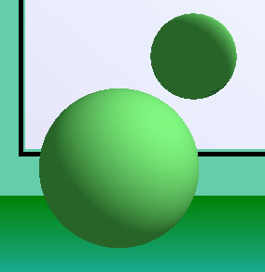
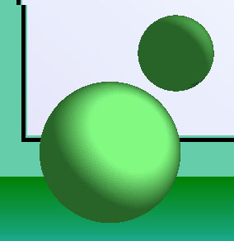
Illumination and Surface Rendering
Basic Illumination Models
Diffuse Reflection
  Fraction of incident light that is diffusely reflected can be set for each surface with parameter ‘d’
  d = N.L/ |N||L|
Specular Reflection / Phong Model
  Result of reflection of the incident light from a concentrated region.
  R=(2*N.L)N-L
  s = (2*d*C)/|N|

Slide 10
Transformations
Rotation
  About all 3 Cartesian axes simultaneously.
  Matrix multiplication
Scaling
  from 0 to 2 times of original size.
Translation (Dragging)
  Left mouse button to drag left, right, up, down.
  Right mouse button to drag in/out.

Slide 11
Reflection about Mirror
The Image tracks all the transformation in the real object.
  Rotation and Scaling
    Rotation about x & y axes result in opposite rotation of image.
    Rotation about z axes result in same effect in image.
    Scaling changes the size of both object and image
  Dragging in all 6 directions
    Dragging sideways (left, right, up, down)
    Dragging in/out

Slide 12
Methodology and Development Tools used
Object oriented approach is chosen for this project.
Event driven programming is also necessary to increase the user interactivity
The development tool used for this purpose in our project is ‘Visual C#.NET”

Slide 13
Problems Faced and Solutions
The programming language ‘C#.NET’ was itself new for us.
constructing Polygon tables.
  Unable to use ‘Edge table’ due to the limited use of pointers in C#.
  So we used only ‘Vertex and Surface tables’.
visible surface detection
  working on the ‘Z-buffer’ algorithm was slow and didn’t produce good results.
  Instead we used ‘back-face detection’ algorithm

Slide 14
Future Enhancement
Due to time limitation and the gravity of the theory involved in Computer Graphics
  Implementation of efficient visible surface detection algorithm for removing hidden surfaces.
  Shadow implementation.
  Gouraud or Phong Shading for Surface Rendering.
  Different View plane of looking the object.
  Perspective projection.

Slide 15
Conclusion
In a limited time, we tried our best to utilize most of the graphics algorithm for 3-D drawing and rendering.
We learned many techniques and algorithms used in Computer Graphics field.
knowledge of C++ and graphics theory was crucial for implementing the graphics techniques in ‘C#.NET’ platform.

Slide 16
References
Computer Graphics, 2nd Edition – Donald Hearn, M. Pauline Baker
Professional C#, 3rd Edition – Simon Robinson, Christian Nagel, Jay Glynn, Morgan Skinner, Karli Watson, Bill Evjen
SAMS Teach Yourself C#.NET in 24 days.
www.google.com
Oreilly C#.Net Programming, 2nd Edition – By Jesse Liberty

Slide 17
Suggestions/Questions???

